Slide 1






Employee Data Analysis using Excel
STUDENT NAME: Ashwin Shankar
REGISTER NO DEPARTMENT COLLEGE
: 312215440
: B.com (General) 3rd year
: Patrician College of Arts and Science

Slide 2
PROJECT TITLE
Employee Performance Analysis using Excel

Slide 3


AGEND
A
Problem Statement
Project Overview
End Users
Our Solution and Proposition
Dataset Description
Modelling Approach
Results and Discussion
Conclusion
3/21/2024 Annual Review

Slide 4

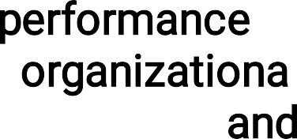
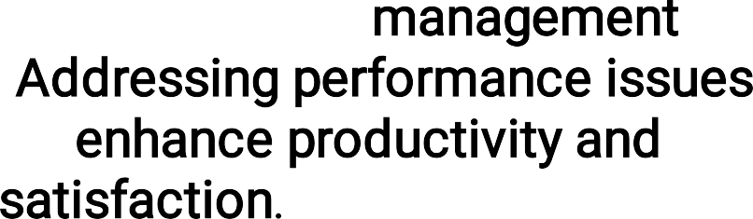




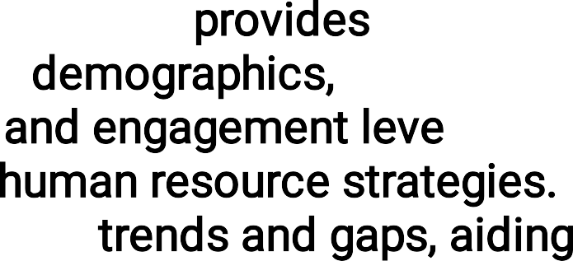
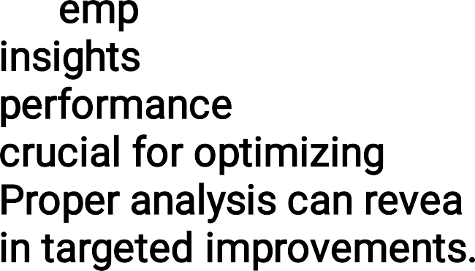

PROBLEM STATEMEN
Em^{T}ployee performance is a critical factor inﬂuencing organizational success, requiring effective assessment and management strategies. Addressing performance issues promptly can enhance productivity and employee satisfaction.
An employee dataset overview provides essential insights into workforce demographics, performance metrics, and engagement levels, crucial for optimizing human resource strategies. Proper analysis can reveal trends and gaps, aiding in targeted improvements.

Slide 5

OVERVIE
PROJECT W
The project involves analyzing employee data using Excel to gain insights into workforce metrics. This includes organizing data, performing statistical analysis, and creating visualizations to understand trends in employee performance, demographics, and other key indicators, thereby supporting data-driven decision-making for HR strategies.

Slide 6
PROJECT FOCUS :
This project focuses on leveraging Excel to analyze employee data. Key tasks include;
**Data Organization:** Importing, cleaning, and structuring employee data for clarity and consistency.
**Analysis:** Applying Excel functions and formulas to assess performance metrics, ﬁlling missing values , and other key indicators.
**Visualization:** Creating charts, graphs, and pivot tables to visualize trends and patterns.
**Reporting:** Summarizing ﬁndings to inform HR strategies and decision-making.

Slide 7

WHO ARE THE END USERS?
The end users in employee performance analysis typically include:
**Human Resources (HR) Managers:** They use the insights to make informed decisions about promotions, training, and development.
**Team Leaders and Supervisors:** They apply performance data to provide feedback, set goals, and manage team performance.
**Employees:** They beneﬁt from feedback and performance evaluations that help them improve and advance in their careers.

Slide 8

OUR SOLUTION AND ITS VALUE PROPOSITION
*Filtering – to ﬁll the missing values.
*Conditional formating- blank values.
*Using- Pivot table & Chart.

Slide 9
Dataset Description
Employee data set- Kaggle There are 26 features
The important ten features are,
Employment ID
*First name
*Last name
*Gender
*Employee status
*Employee type
*Employee classiﬁcation
*Performance score
*Current employee ratings
Business units

Slide 10

THE "WOW" IN OUR SOLUTION
Performance Level– There are categories into Levels such as very high,high,med,low,etc...
Using Pivot table and charts is to analyse the employees performance.
3/21/2024 Annual Review
10

Slide 11
MODELLIN
G
*Data Preparation: Clean and organize data, ensuring accuracy and consistency.
*Trend Analysis: Apply charts and graphs (e.g., line charts, bar graphs) to visualize trends over time, such as employee performance or turnover rates.
*Pivot Tables: Create pivot tables to aggregate and analyze data across different dimensions, such as department, tenure, or job role.
*Regression Analysis: Utilize regression functions to identify relationships between variables, such as the impact of training on performance.
11

Slide 12
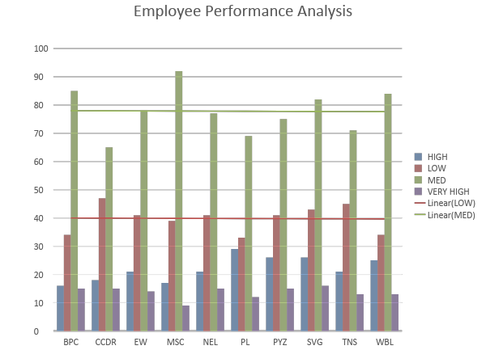
RESULT S
11

Slide 13
conclusion
The conclusion of employee data analysis reveals key insights into workforce trends, performance, and areas for improvement. By analyzing metrics such as productivity, turnover rates, and engagement levels, organizations can identify strengths and weaknesses in their HR strategies. This analysis supports data- driven decision-making, enabling targeted interventions to enhance employee performance, optimize recruitment processes, and improve overall organizational effectiveness. In essence, effective data analysis provides a foundation for strategic planning and operational improvements, leading to a more motivated and productive workforce.

